Slide 1
Art
11. Tag questions

Slide 2
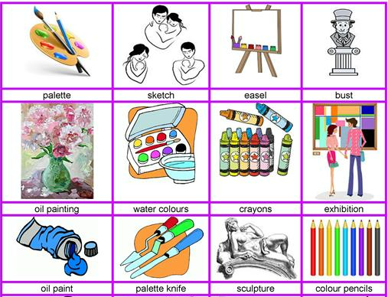
Art
Do you like going or watching comedy shows?
Do you enjoy visiting museums?
Do you like going to the theater?
Do you have an artistic talent?

Slide 3
Tag questions
We can add question tags like isn't it?, can you? or didn't they? to a statement to make it into a question. Question tags are more common in speaking than writing.
We often use question tags when we expect the listener to agree with our statement.
When the statement is positive, we use a negative question tag.
This painting is beautiful, isn’t it?
If the statement is negative, we use a positive tag question.
The joke was not funny, was it?
Notes:
Practice start at
Grammar show Tag Questions (advanced)
https://www.youtube.com/watch?v=RpunLrghIjo

Slide 4
Intonation and answers
When we are 80% sure that we are correct with our statement, we will increase our tone for the tag question.
When we are certain that we are correct with our statement, we will decrease our tone for the tag question.
When we answer these type of questions, we will always answer to the statement, not the tag question.
Questions | Agree | Disagree
You hate modern art, don’t you? | Yes, I do. (I hate modern art.) | No, I don’t. (I love modern art.)
You don’t like cubism, do you? | No, I don’t. (I hate it.) | Yes, I do. (I love cubism.)
Notes:
Practice start at 6:22
https://www.youtube.com/watch?v=YTbGMGcyLPo

Slide 5
Choose the correct tag question
Aki didn’t say much, had he / did he ?
I wasn’t rude, was I / wasn’t I ?
We should have memorized our lines, haven’t we / shouldn’t we ?
None of the speakers are working, are they / aren’t they ?
I’m giving the next presentation, aren’t I / am I ?
She can’t play her part, can she / can’t she ?
You usually have drama lessons on Monday, don’t you / doesn’t you ?
The singer is good looking, isn’t he / doesn’t he?
An art exhibit has been held here before, wasn’t it / hasn’t it?
Water colors shouldn’t be this expensive, could they / should they?
Notes:
Did he
Was I
Shouldn’t we
Are they
Aren’t I
Can she
Don’t you
Isn’t he
Hasn’t it
Should they

Slide 6
Tag questions, structure
The style is interesting, isn’t it? (present)
You weren’t an amateur comedian, were you? (past)
He has had a gallery in downtown, hasn’t he? (present perfect)
She had not had a famous exhibition, had she? (past perfect)
Exception: I am a great actress, aren’t I? (present)
Notes:
Tag questions
https://www.youtube.com/watch?v=foyWhOHhTT0

Slide 7
Complete using tag questions
Jane and Jenny are working on a new play, _____?
Larry is in an amateur theater group, _____?
You aren’t in a bad mood, _____?
I’m not very good at acting, _____?
Bette Paltrow isn’t giving an exhibition this week, _____?
We’re going to a play this evening, _____?
You are an amateur actress, _____?
The art gallery isn’t closed, _____?
I’m sorry! I am in a bad mood, _____?
The paintings aren’t very good, _____?
Notes:
1. aren’t they
2. isn’t he
3. are you
4. am I
5. is she
6. aren’t we
7. aren’t you
8. is it
9. aren’t I
10. are they

Slide 8
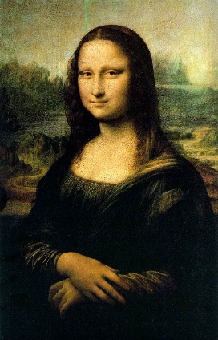
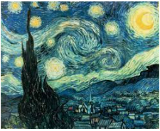
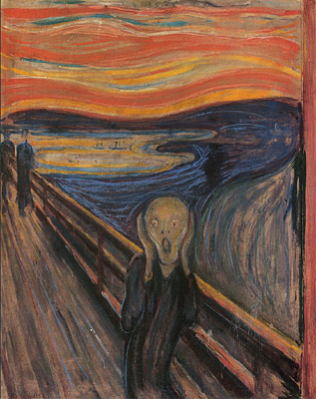
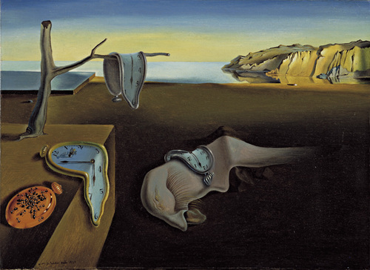
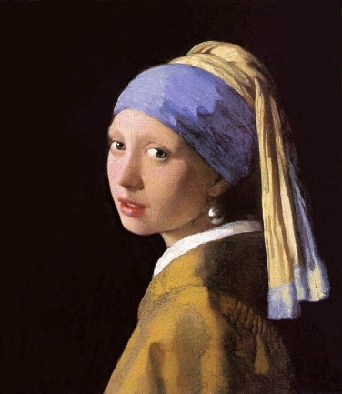
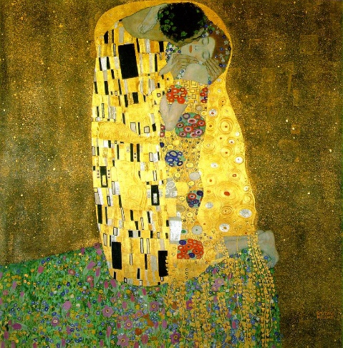
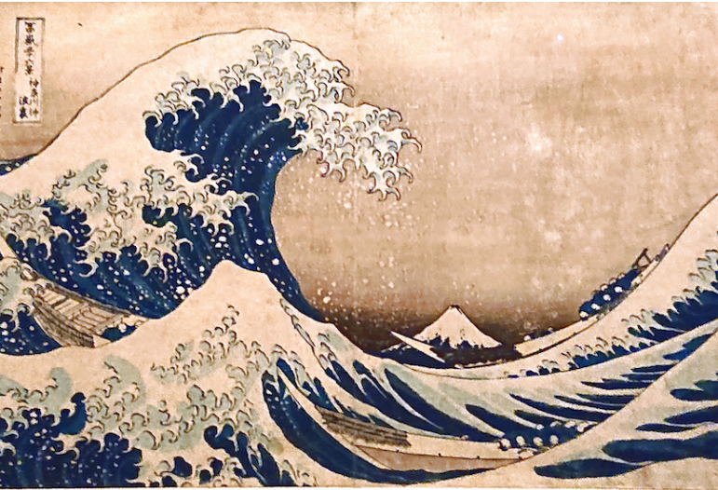
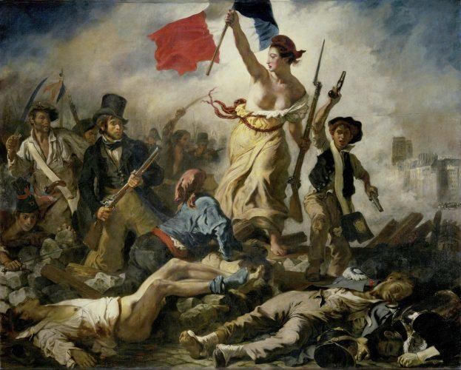
Guess the painter and paint
Examples:
Number 1 is La Gioconda, isn’t it?
Number 1 was painted by Leonardo da Vinci, wasn’t it?
1
2
3
4
5
6
7
8
Notes:
Mona Lisa by Leonardo da Vinci
Starry Night Vincent van Gogh
The Scream, Edvard Munch
The Persistence of Memory, Salvador Dali
Girl with a Pearl Earring, Johannes Vermeer
The Kiss, Gustav Klimt
The Great Wave off Kanagawa by Hokusai
Liberty Leading the People by Eugène Delacroix

